Slide 1
Did you take the SAT or the ACT?
A quick glance at boosting SAT Participation in 2018 and beyond.

Slide 2
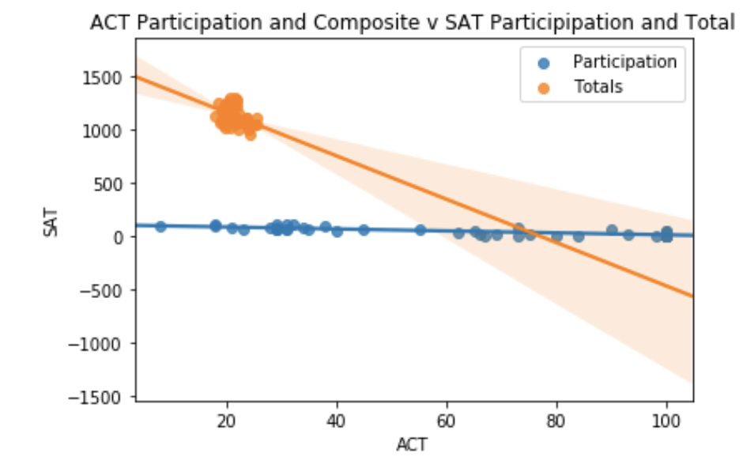
How the ACT is hurting the SAT
In states where SAT participation is at its highest ACT is at its lowest.
States where participation for both exams is ABOVE 50%: Florida, Georgia, Hawaii,
Avoid states with mandatory ACT testing:
Alabama
Montana
Nevada
North Carolina
North Dakota
Utah
Wisconsin

Slide 3
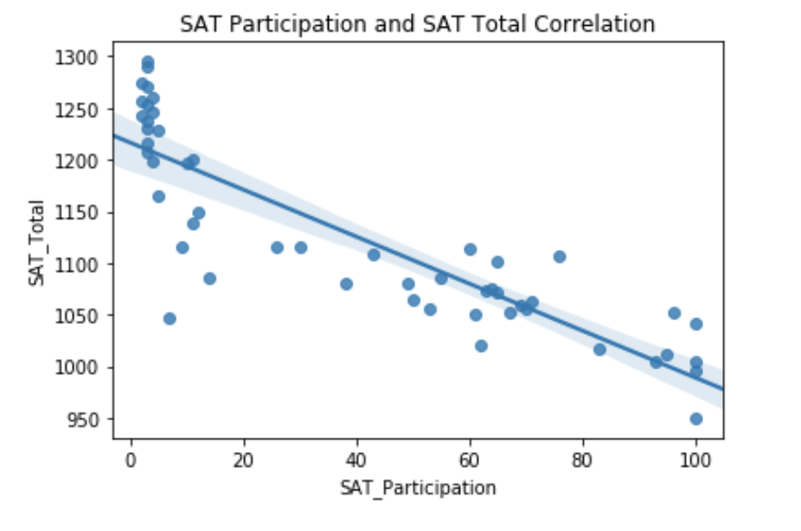
The more they take, the less they make!
As participation goes up, test scores go down.
The answer is to find the states where participation AND test scores are higher and learn from their models.
Massachusets has a participation rate of 76% and an average score of 1107. 47 points higher than the national average.

Slide 4
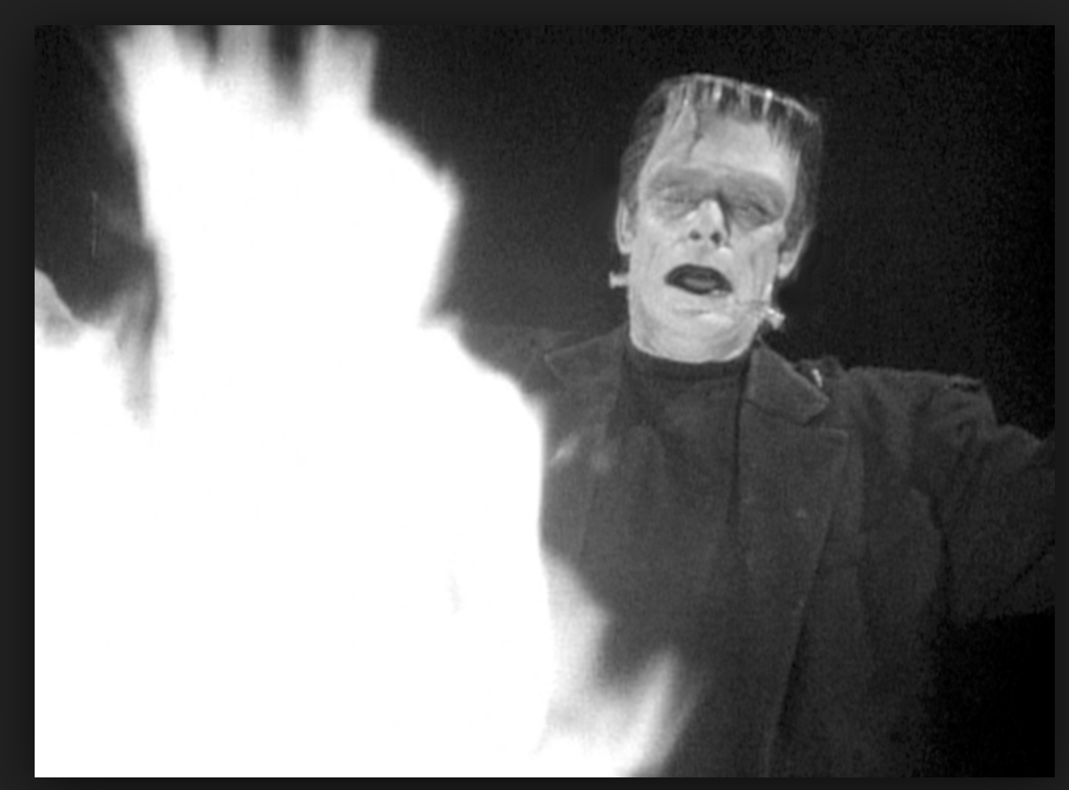
“MANDATORY TESTING BAD!!!!”
“TARGETED MARKETING IN KEY SCHOOL DISTRICTS IN KEY STATES GOOD!!!”

Slide 5
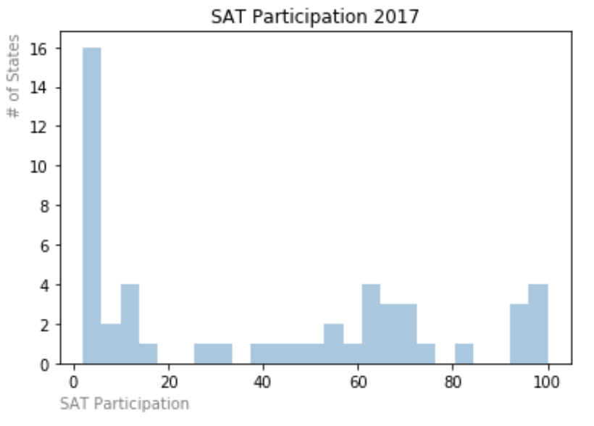
Let's make the SAT great again!
46% of states have BELOW 20% participation in the SAT exam.
No need to go after states who already have 100%: Washington DC, Connecticut, Delaware and Michigan.
Average ACT participation was 65% in 2017 while average SAT participation was 40%.
Lots of room for growth, need to focus on the low hanging fruit.

Slide 6
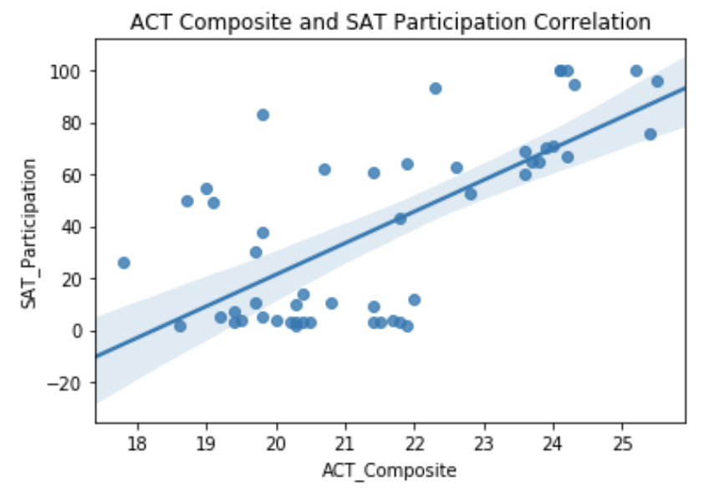
On the positive side…..
States with higher ACT scores have higher SAT Participation rates.
Focus effort on states where ACT scores are above the national average of 21, SAT participation is below 20% and ACT Participation is below 80%: Ohio, Iowa and Kansas

Slide 7
Where do we go from here?
Focus your efforts in areas where SAT participation is lower than 15% and ACT participation is lower than 75% to allow room for growth: West VA., Ohio, New Mexico and Iowa.
Avoid states with mandatory ACT testing.
States with higher ACT scores have higher SAT Participation rates: focus attention on Ohio, Iowa and Kansas.
Follow what works, with further data analysis of Massachusetts SAT testing model we could determine some factors leading to both high participation and high test scores.
Questions ???

